Slide 1
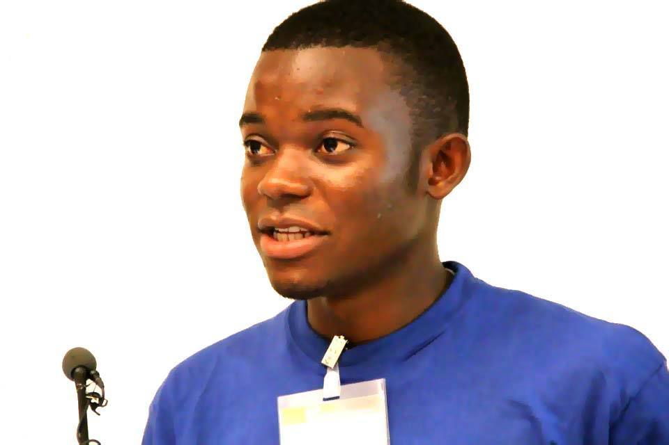
Brighton Kaoma 22 years old
Co-founder & Executive Director
Agents of Change Foundation
Email: brightonkaoma@yahoo.com
Phone: +260 962 919108

Slide 2
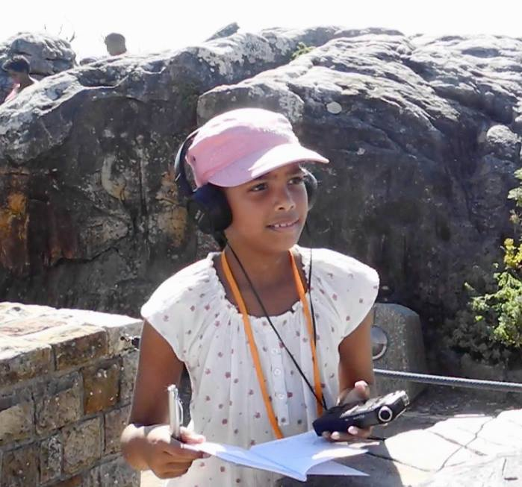
Established in December 2013, Agents of Change Foundation trains and equips young people with skills in the use of radio technology, to meet the aforementioned challenges.
But why radio?
Radio is CHEAP intimate medium of voices, stories, and dialogue.
It allows young people to share personal experiences
Radio is easy to learn-it requires minimal technical expertise
It is universal and the most widespread.

Slide 3
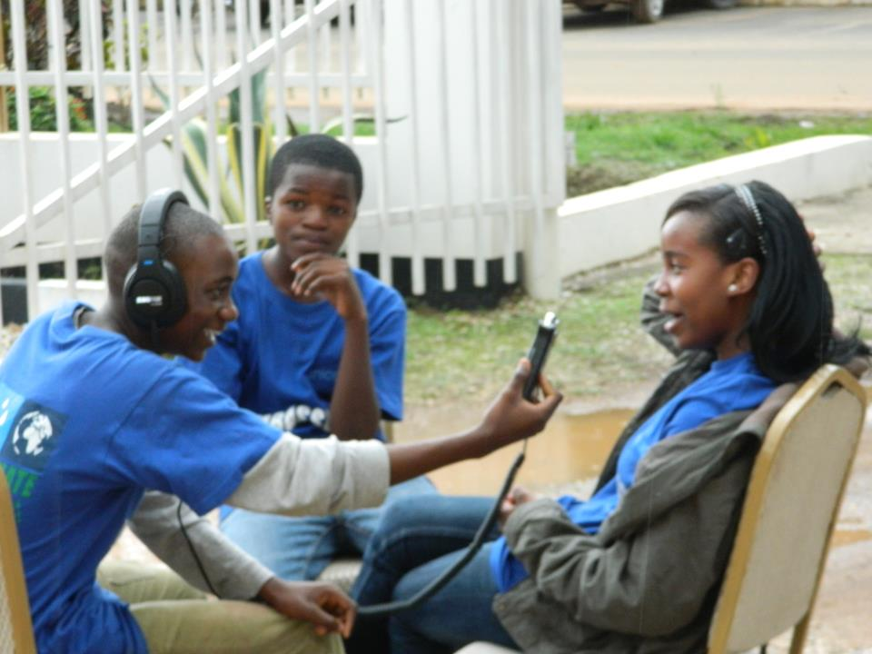
Design Workshop- Zambia U-Report, Oct 17-19th 2012
Using radio as a vehicle for Change: “Agents of Change”
Train
Empower
Training of 40 young reporters in Lusaka, September 2015 .
Activate
Mentor
Notes:
1) Zambia National AIDS council with UNICEF support, brought together a group of stakeholders (involving young people, ICT and telecoms experts, HIV experts, Communications Expert, Educators/parents) to design an innovative national platform to accelerate HIV response among young people – Zambia Ureport. Zambia received technical support from UNICEF Uganda where Ureport was first created.
2) Zambia Ureport was launched on the first of December 2012 (World AIDS Day) by the Government of Zambia with 4 objectives – the acronym PLUM makes it easier to remember.
The Ureport SMS platform was expected to create the enabling environment for young people:
To Participate in defining the right policy and programme to meet their needs (filling the other half of the glass)
To Learn in a new ways to improve their comprehensive knowledge about HIV
To Utilize the services that are available in their communities including the health facilities
To Monitor the overall quality of services.
3) We then built 2 modules that describe the strategies to meet the programme objectices:
Module 1: Knowledge Bank
Module 2: Polls and Campaigns.

Slide 4
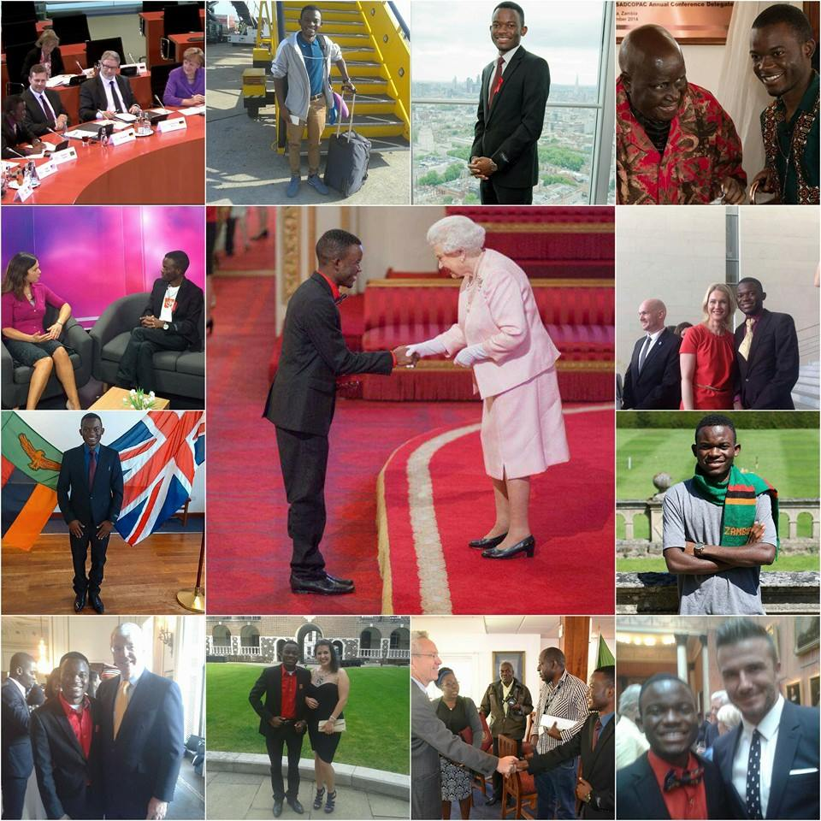
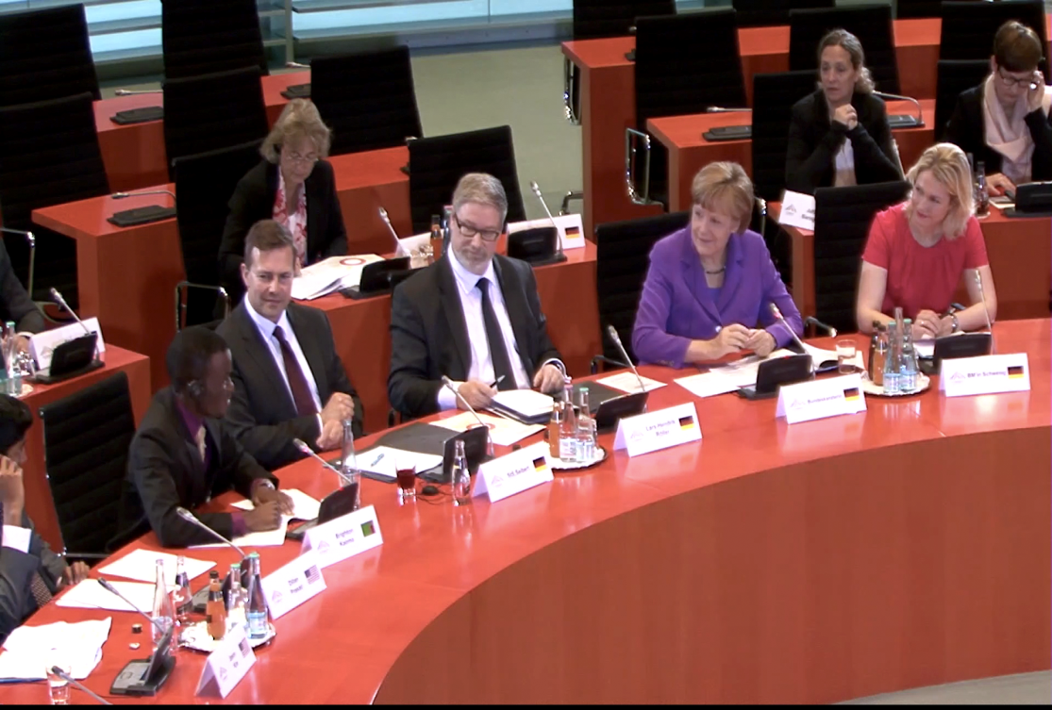
Young People’s Voices → Influencing Policy Change
Activating Action
Brighton Kaoma- Speaks about the work of Agents of Change in addressing climate change with Chancellor Angela Merkel at the Germany Chancellery in Germany.
12 th May, 2015
Her Majesty Queen Elizabeth II, David Beckham and Sir Johm Major recognises the work of Agents of Change.
27 th June, 2015 at Buckingham palace.
Notes:
Within a year of implementation, young people in the programme were already influencing national policy on HIV…Here Natacha and Solomon delivery the Voice of Youth, before the Vice President of Zambia, at the National HIV prevention convention in 2013. This statement was prepared following SMS poll of 15,000 Ureporters 2 weeks before the conference.

Slide 5
Supported by the Children’s Radio Foundation and the 11th Hour Foundation.

Slide 6
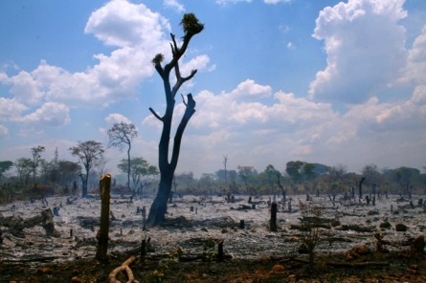
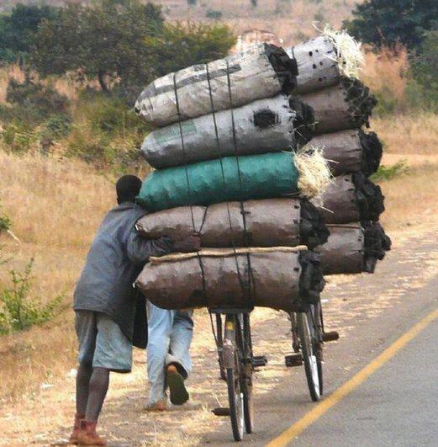
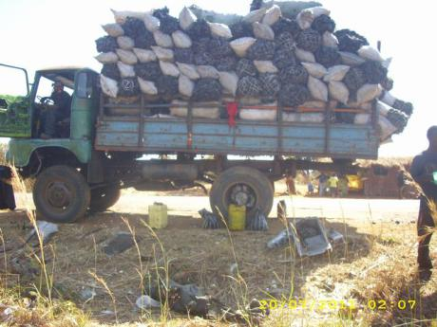
Unite4Climate Radio Initiative
With an estimated loss of 300,000 hectares per year, Zambia has one of the highest deforestation rates in the world, contributing significantly to global greenhouse emissions.
The initiative involves 100 youth reporters across 3 provinces of Zambia.
Working with 10 adult mentors from 5 partner radio stations.
Youth Reporters running weekly climate change themed radio shows

Slide 7
The initiative promotes dialogue around the following key topic sub-areas:
Community-based practices contributing towards deforestation.
Agricultural economies and food insecurity.
Power consumption and alternative forms of energy.
Youth-driven activations leading towards pursuing mitigation of the effects of climate change.
Engaging elders and community leaders towards collective efforts.

Slide 8
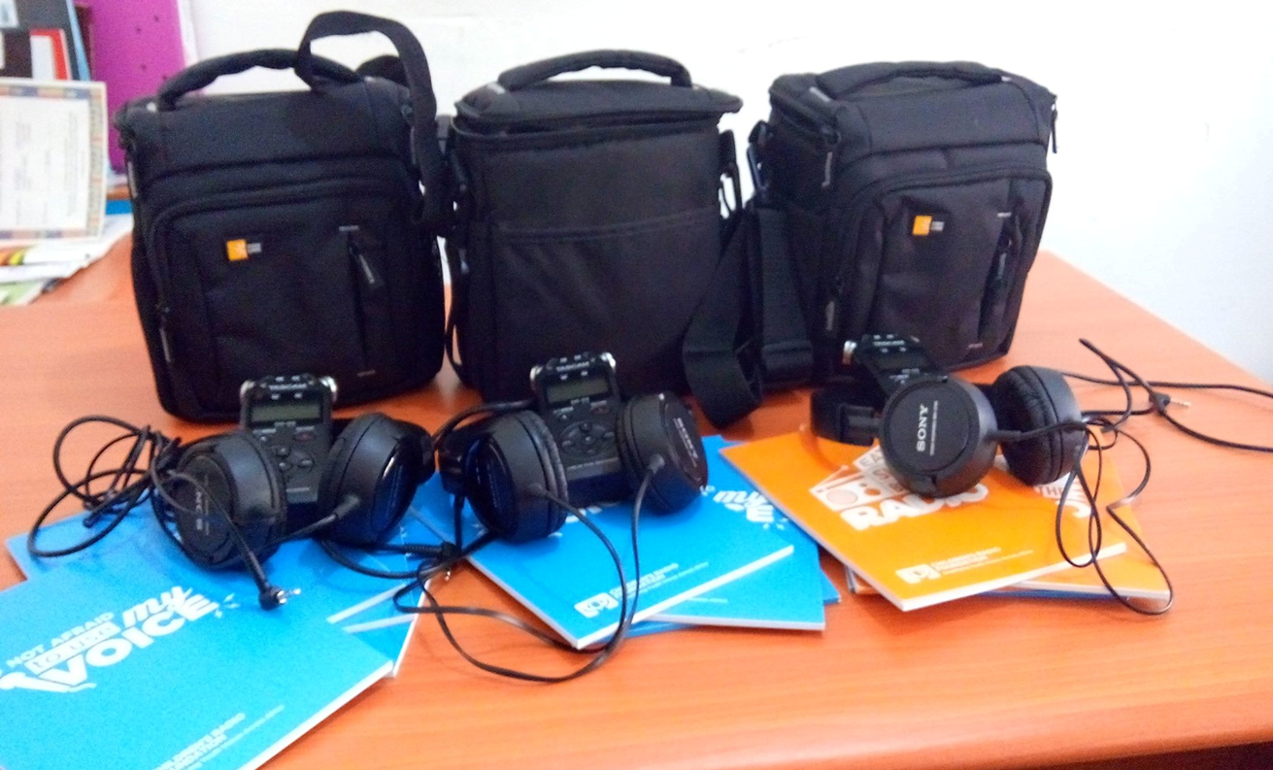
PROVISION OF EQUIPMENTS TO PARTNER RADIO STATIONS

Slide 9
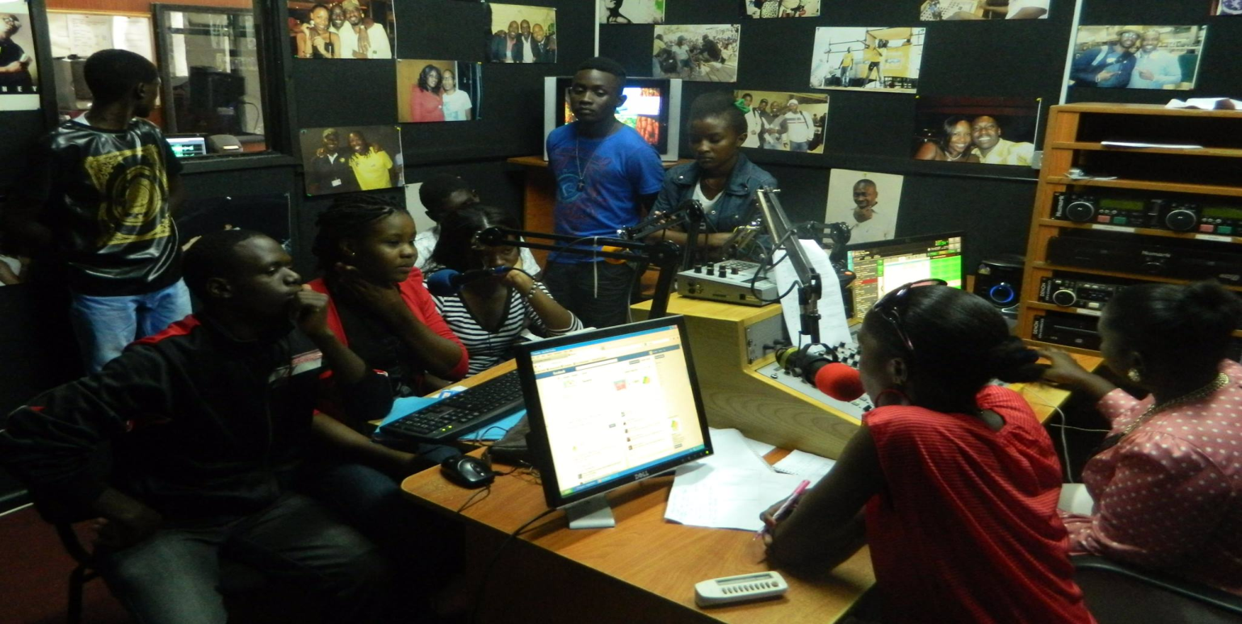
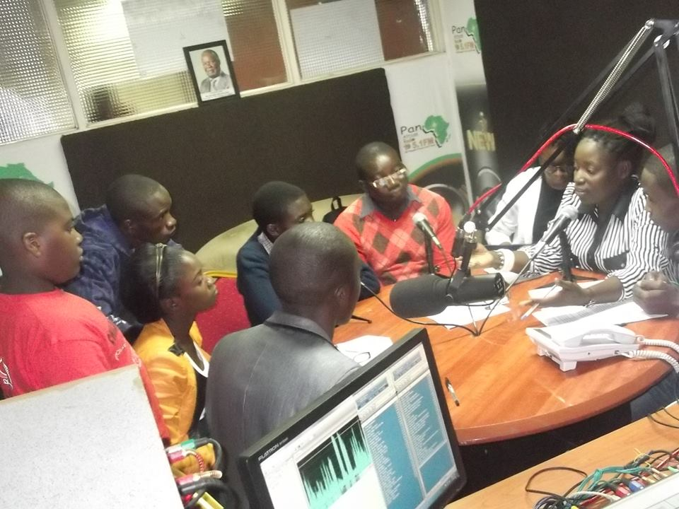
Focused on positioning community radio stations as dialogue hubs around issues of climate change

Slide 10
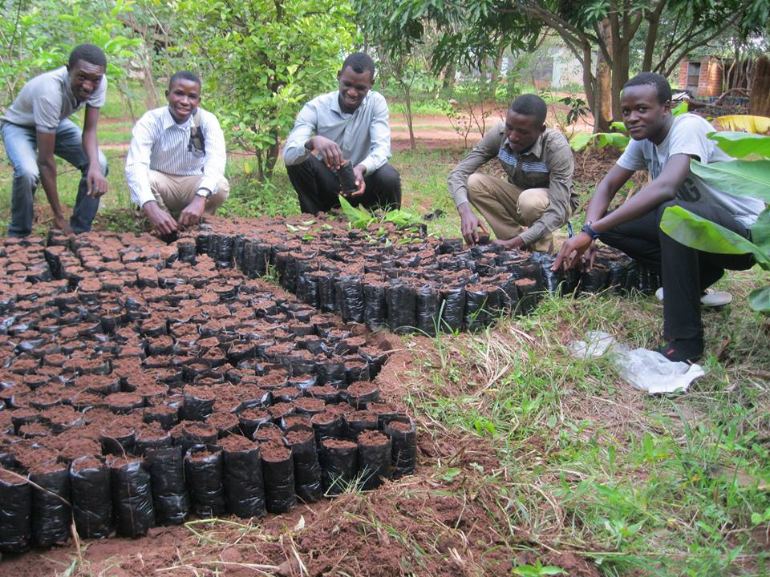
Our youth reporters host quarterly outreach events involving the radio stations, youths and the community
Tree Planting, Tree nursery establishment & sensitization in schools and communities

Slide 11
Other examples to engage youth
BIRAME TEDA is an association of university students in science at University of Rwanda.
Youth Volunteers for Environment
In order to engage youth, Imbere heza had a 7min magazine for children. Done by a child, children have been interested in listening to an agriculture radio show, about coffee farming.

Slide 12
THANK YOU

Slide 13
Environmental JOURNALISM
Successful techniques of reporting on environmental-based stories

Slide 14
Group work:
What are the key challenges in reporting about environmental and climate change stories?
What may be the Successful techniques of reporting on these stories?
What is the exact role that media has to play in reporting about climate change stories?

Slide 15
REMEMBER - Proximity
People pay more attention to:
What happening now
What affects their job
What affects their children and their money
And what is happening where they live
EVERY CLIMATE CHANGE RELATED STORY CAN BE LOCALIZED TO HAVE MORE IMPACT ON BEHAVIOR CHANGE TOWARDS MITIGATION AND ADAPTATION STRATEGIES

Slide 16
Start by making it:
Simple
Precise
timely
Local specific
Be in local language
Based on facts/scientific research
Needed based of local people
be interesting to end users

Slide 17
E.g. of successful programs:
iSeeChange
Weekly news bulletins and short magazines – Developing Radio Partners
Weekly 30min magazines – Radio Lifeline
Agents of Change in Zambia
Participatory radio campaigns – Farm Radio: a planned, radio-based activity, conducted over a specific period of time (usually four-six months)

Slide 18
TIPS
1. Listen to the farmer’s experience
Community radio can be used to improve the sharing of environmental information by remote local communities.
2. Using local languages to communicate directly with local people and listeners’ groups.

Slide 19
TIPS…
3. A format that combines a drama performed by local actors ...
4. Use of different Angles – Environment, agriculture and climate change can be approached as a business or economic story, a scientific story, a health story, a social and cultural story, a security story, and so on. Reporting on these issues from different angles not only broadens your appeal and your audience, but makes the reporting more fun.

Slide 20
Tips…
Focus on People – Stories centered on individuals, rather than issues, are generally more appealing, and focusing on case studies of local people, agro-ecologists and researchers in the field help audiences to see what is (and isn’t) people. And the subjects don’t just have to be success stories; efforts that failed can be just as interesting and even more enlightening.

Slide 21
Tips…
Avoid (or Explain) Jargon – As with any complicated or scientific topic, environment and climate change is a topic loaded with jargon – complex words and phrases that experts toss off easily but lay audiences struggle to understand.
Try to avoid jargon wherever possible, or if you must use them, explain the terms in simple and easy-to-understand language…

Slide 22
Tips…
E.g. instead of saying that a particular insect's egg is 0.25 mm, it is better to say that it is of the size of the full stop put at the end of this sentence (if it is in writing).
Or, you can compare something with what the audience (local community) see in their daily life.
e.g. 10ml can be compared to the cover of the soda bottle…

Slide 23
Tips…
Translate the Science – when interviewing scientists, economists and other experts, think of yourself as an interpreter who needs to translate the language of this expertise into common terms that everyone can understand.
(Simple example - Instead of saying, 82.5% of the farmers are healthy, just say, if you have a group of 10 farmers, approximately 8 of them are healthy)

Slide 24
Tips…
Focus on Solutions, Not Just Problems – This may seem obvious given that climate change is essentially presented as solutions, but given the media’s (and many editors’) preference for highlighting problems and crises, and so on. Certainly, these are worthy topics to explore. But too much gloom and doom can generate apathy, fatalism and ultimately a loss of interest by the audience.

Slide 25
Tips…
Explore All Sides – More broadly, try to report on all sides of the topic, space permitting. You may be reporting a series of stories.
Use descriptions of what you see and how you want the audience to see it– A descriptive image is worth a thousand words.
Social media is of course another tool that modern reporters have come to rely on to distribute stories more widely, get feedback and indeed find sources and information.

Slide 26
Tips…
Focus on problems today: There are many underreported stories of the harm being done by industrial agriculture today, harm that agro-ecology would avoid and could repair. It is important for journalists to remind readers about certain facts: undernourishment, new chemical compounds in the environment, imbalance in funding between microbiology and sustainable agriculture. And remind them of the opposite messages they’re often bombarded with.

Slide 27
E.g of an angle:
It’s not just about farming, it’s about food. Help connect the dots between the field and the dinner table. Remind your audience of the relationship between their daily bread/rice/porridge and rainforest destruction, groundwater depletion and contamination, climate change and cancer; but open their eyes to the world of alternatives, too.

Slide 28
Remember regular journalism tips:
Story selection and focusing
Nurturing reporters to be the best on-air storytellers
Better writing that uses spoken language
Diversity of sources
The Reporter Question: When should a reporter ask questions within his or her stories?
Joy

Slide 29
Nnaemeka Ikegwuonu
shares his experience in
climate change reporting

Slide 30
THANK YOU!

Slide 31
Radio Magazine Production

Slide 32
Remember:
Keep simple language
Structure and arrange arguments clearly
Make main points brief and talk about them regularly
Keep important information at the beginning
The script have to be very clear and convincing
Summarize talk clearly

Slide 33
Technics:
Put the audience at the center of your production
Use multiple formats – including descriptive ones
Mix well
Add interesting things – think outside the box
Play with the spoken word, the music and the sound effects
Remember ways to collect and air target audience feedback
Make sure to have a suitable jingle

Slide 34
Some popular formats for
the 30 min magazine:
Vox Pop
Interview
Reportage
Discussions (including debates)
Profiles
Documentaries/feature stories
Quizzes
Drama
Call-ins/SMSs

Slide 35
Plan for the topics
Example of “URUBUTO NTERA” planned in Rwanda for the climate change weekly radio show to be produced

