Slide 1
HOW CLIMATE CHANGE AFFECTS WILDLIFE AND FRAGILE ENVIRONMENTS
Immaculate k. Mkong
Journalist & Head of Communication Division
communication@erudef.org
Louis Nkembi
President/CEO
Louis.nkembi@erudef.org

Slide 2
INTRODUCTION
Climate change is a large-scale, long-term shift in the earth’s weather patterns or average temperatures.
This is also called global warming.

Slide 3
Causes
The primary cause of climate change is the burning of leftover fuels, such as oil and coal, which emits greenhouse gases into the atmosphere—primarily carbon dioxide.
Other human activities, such as agriculture and deforestation, also contribute to the proliferation of greenhouse gases that cause climate change.

Slide 4
Effects
Rising sea levels due to the melting of the glacial ice caps (again, caused by climate change) contribute to greater storm damage;
Higher temperatures are associated with stronger and more frequent storms

Slide 5
Effects cont’d
Additional rainfall, particularly during severe weather events, leads to flooding and other damage
An increase in the incidence and severity of wildfires threatens habitats, homes, and lives.
Heat waves contribute to human deaths and other consequences.

Slide 6
Many threatened species live in areas that are severely affected by climate change. And climate change is happening too quickly for many species to adapt.
Below are few examples of how climate change increases the challenges we’re already facing in our conservation work …

Slide 7
Climate Change and Wildlife
Gorilla
Elephant
Chimpanzee

Slide 8
The Cross-river Gorilla
The cross river gorilla is currently the world’s rarest great ape, with a population of only around 250-300 restricted to a small area of highland forest on the border of Cameroon and Nigeria (Lebialem highlands conservation complex)
Suffers threats that include habitat loss due to bushfires caused by climate change

Slide 9
Elephant
elephants face a range of threats including shrinking living space, which brings them more frequently into conflict with people

Slide 10
changes in rainfall brings too much rain – causing floods – or too little rain –causing drought and wildfires; habitats to become unsuitable for the elephant to live in.
African elephants drink up to 225 litres of water each day, changing weather patterns cause them to move outside protected areas in search or water
increases animal-human conflict and risk of being poached. (the incidence at KNP)

Slide 11
The Cameroon-Nigeria Chimpanzee This specie is particularly vulnerable to climate change since half of its entire population survives in lowland forests greatly affected by global warming

Slide 12
Climate change and Forests
forests soak up carbon dioxide and help regulate the global climate. They also serve as habitat to threatened plant and animal species.
Longer periods of hot weather stress trees, and make them more susceptible to wildfires, insect damage, and disease.

Slide 13
Climate change increases the size and number of forest fires, insect outbreaks, and tree deaths causing the disappearance of our forests

Slide 14
Climate change and Water
Freshwater environments are already under excessive pressure from drainage, pollution, extraction, and invasive species.
Climate change - changing rainfall and evaporation patterns have made drought and flooding to be more common today, causing displacement and conflict. (Floods in Adamawa, North, North West of Cameroon)

Slide 15
Widespread floods, as the glaciers melt, are being followed by long-term water shortages, and massive humanitarian, social (cholera) and environmental problems. Less fresh water means less agriculture, food and income

Slide 16
Threat to Mangroves
Mangrove ecosystems serve as breeding, feeding, and nursery grounds for many shellfish, fish, and other wildlife.
Rising sea levels and changing salinity pose the most serious threats to these ecosystems.
Loss of mangroves have a serious economic impact on both fisheries and coastal communities. (Kribi and Limbe)

Slide 17
Cameroon mangrove threatened by climate change and unregulated human exploitation

Slide 18
ERuDeF Efforts in Mitigating the effects of Climate Change
Protected Area creation & Mgt
Agro forestry Dev’t
Restoration of Degraded Landscape
Training
Community & School Education
Communication

Slide 19
PA Creation & Mgt
ERuDeF, through its Biodiversity conservation program is determined to create and properly manage a series of protected areas in Cameroon and beyond.
(Tofala Hill Wildlife Sanctuary, Proposed Mak- Betchou wildlife Sanctuary, Tofala-mone forest corridor, etc)
The creation and mgt of protected areas keep forest resources intact, and provide a safe haven for endangered wildlife species.

Slide 20
Agro forestry Devt
Through the Agro forestry and Economic development program, ERuDeF encourages the cultivation of nitrogen fixing and agro forestry tree species in farms. These trees don’t only improve soil fertility and yields, but help absorb excess carbon dioxide emitted into the atmosphere, hence mitigating climate change.
This program in operational in 4 regions of Cameroon; SW, West, Littoral and North West.

Slide 21
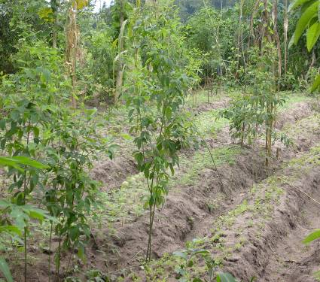
Tree planting and demonstration of agroforestry system (allay cropping)

Slide 22
The program has introduced the Forest Garden approach which makes the fight against climate change even easier

Slide 23
Protection of water catchments to ensure water supply and avoid water scarcity due to climate change
(Mt. Cmr and Lebialem)

Slide 24
Restoration of Degraded Landscape (through tree planting)
The Conservation of Threatened trees of Mount Cameroon project is focus on the regeneration of threatened trees species and the reforestation of degraded landscapes.
ERuDeF owns a 30000 capacity tree nursery containing threatened tree species that are nursed and planted back into degraded forests.

Slide 25
Training
The ERuDeF Institute of Biodiversity and Non-profit studies (EIBiNS) located in Buea has graduated two batches of conservation leaders with knowledge in fields that include but not limited to agro forestry mgt, biodiversity conservation, environmental journalism, Applied social research, Environmental and mountain studies, NGO and fundraising studies, etc
The trainee graduates with a mastery of global environmental threats like climate change and ways to mitigate them

Slide 26
Community & School Education
The Education for Sustainable Development (ESD) program carries out education in schools and communities on conservation threats, the dangers of climate change and ways of mitigating them.

Slide 27
Conservation education in schools

Slide 28
Communication
Sensitization through the GVN
Online Media (E- newsletters)
Production of environmental films and documentaries (CEFM)
Green Vision radio and TV underway

Slide 29
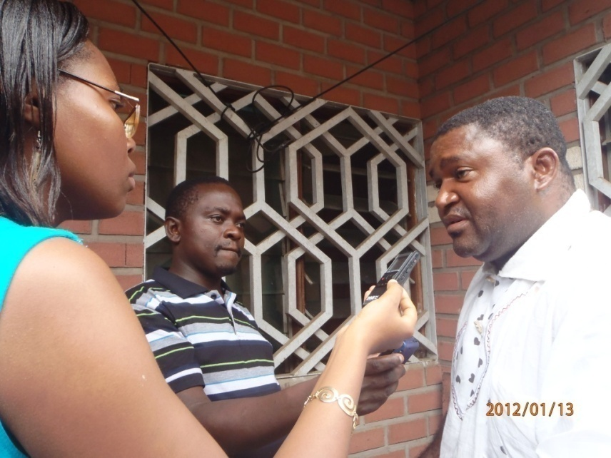
Media visits to community radio stations and press conferences to educate the public on the dangers of climate change and ways to fight it

Slide 30
THANKS FOR YOUR KIND ATTENTION

